Slide 1
SESSION 5
RELATIONAL (SQL) VS NON-RELATIONAL (NoSQL) DATABASE
Prof J.W. Muteba Mwamba

Slide 2

Databases
Database systems store data and provide a means of accessing, updating, manipulating, and analyzing data
Databases are stored in files on a file system, but they are arranged in a manner that allows for fast queries and updates
A Database Management System (DBMS) is designed for programmers to communicate with the Database:
Relational (SQL) DBMS
Non-Relational (NoSQL) DBMS
MySQL
PostgreSQL
Oracle
Microsoft SQL Server
IBM DB2
MongoDB
Firebase
Apache CouchDB
Apache Cassandra
Hadoop

Slide 3
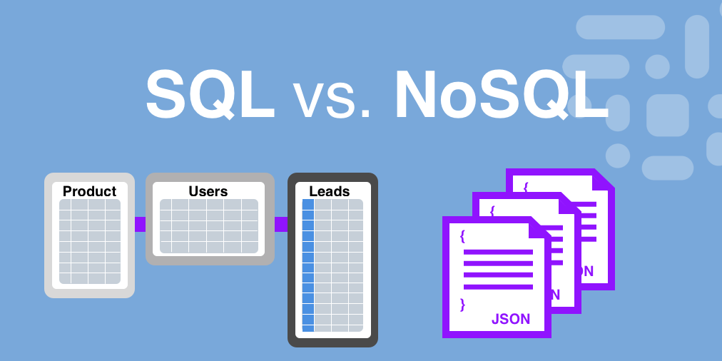
Relational Vs Non-Relational Database

Slide 4
Non-Relational Database: NoSQL
A NoSQL (originally referring to "non-SQL" or "non-relational") database provides a mechanism for storage and retrieval of data that is modeled in means other than the tabular relations used in relational databases.
NoSQL databases are increasingly used in big data and real-time web applications. NoSQL systems are also sometimes called Not only SQL to emphasize that they may support SQL-like query languages
For example, terabytes of user data generated by companies like Twitter, Facebook and Google need NoSQL for storage
a NoSQL database systems can store structured, semi-structured, unstructured and data
Notes:
Data is store in document format. Example of tweets (tweet handle, name, location,..)

Slide 5
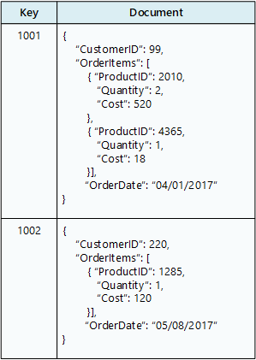
Example of Non-Relational Database (Java script)

Slide 6
Relational Database – Table Structure
OverallGrades
.
prefix | num | fname | lname | letterGrade
CSCI | 103 | Sheldon | Cooper | A
CSCI | 104 | Howard | Wolowitz | A-
CSCI | 201 | Leonard | Hofstadter | A
CSCI | 201 | Howard | Wolowitz | B
EE | 101 | Howard | Wolowitz | B-
Non-normalized
Class
Normalized
Student
classID | prefix | num
1 | CSCI | 103
2 | CSCI | 104
3 | CSCI | 201
4 | EE | 101
studentID | fname | lname
1 | Sheldon | Cooper
2 | Leonard | Hofstadter
3 | Howard | Wolowitz
4 | Rajesh | Koothrappali
Grades
gradeID | classID | studentID | letterGrade
1 | 1 | 1 | A
2 | 2 | 3 | A-
3 | 3 | 2 | A
4 | 3 | 3 | B
5 | 4 | 3 | B-
Tables are called relations
Columns are called attributes
Rows are called tuples
Connections are called relationships

Slide 7
Relational Database Terminologies
** Database - contains many tables
** Relation (or table) - contains tuples and attributes
** Tuple (or row) - a set of fields that generally represents an “object” like a person or a music track
** Attribute (also column or field) - one of possibly many elements of data corresponding to the object represented by the row
** A database administrator (DBA) is a person responsible for the design, implementation, maintenance, and repair of an organization’s database.
** A database model or database schema is the structure or format of a database, described in a formal language supported by the database management system

Slide 8
Accessing Data from Database
.
Input
Files
Python
Programs
Database
File
SQL
R
SQL
Output
Files
Excel
MySQL/SQLite
Browser
You
Java
Notes:
You as data engineer can connect to the Database via:
DBMS such as MySQL
Via Python environment

Slide 9
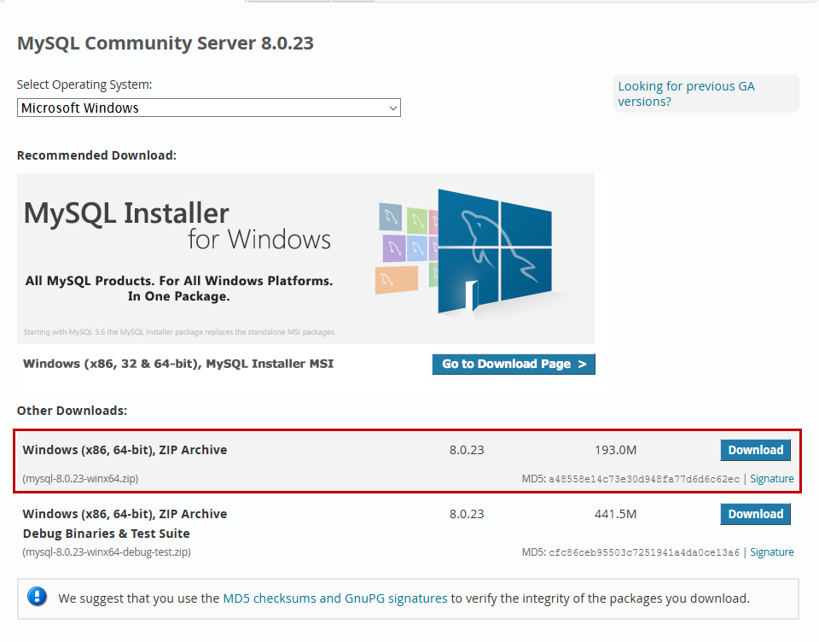
Download MySQL
Download from: https://dev.mysql.com/downloads/mysql/
You will need to create an Oracle account to download MySQL Command Prompt/Line and MySQL Workbench from the same URL
JDBC Tutorial
Notes:
To create an account: https://profile.oracle.com/myprofile/account/create-account.jspx

Slide 10
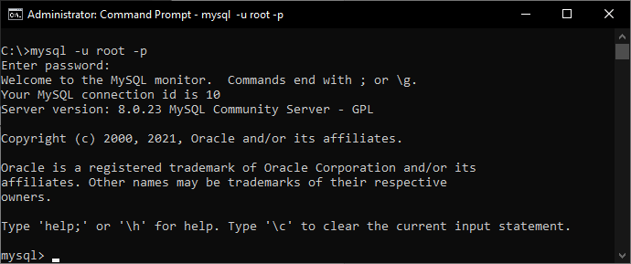
MySQL Command Prompt
Notes:
Launching MySQL command prompt/line
During the installation process you will be required to set up a password, create an Oracle account! (MySQL is a Oracle product)
You have 1 minute to install MySQL on your computer!

Slide 11
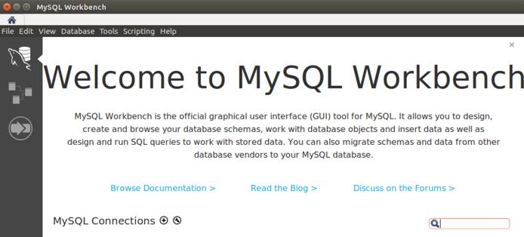
MySQL Server using Workbench
Notes:
In addition to the MySQL command prompts, MySQL Workbench a graphical user interface (GUI) will automatically be installed on your computer if possible! Recently, it has become a stand alone package

Slide 12
SQL Table Structure
Do not replicate reference data point (key is unique)
Use integers for keys and for references
Add a special “key” column to each table which we will make references to. By convention, this is called “id” column.

Slide 13


Three Kinds of Keys
Primary key - generally an integer auto-increment field
Logical key - What the outside world uses for lookup
Foreign key - generally an integer key pointing to a row in another table

Slide 14
MySQL Data Types
Integer | Real | Text
TINYINT | FLOAT | CHAR (<length>)
SMALLINT | DOUBLE | VARCHAR (<maxlength>)
MEDIUMINT | DOUBLE PRECISION
INT | REAL
INTEGER | DECIMAL
BIGINT | DEC
BINARY | NUMERIC
 | FIXED

Slide 15
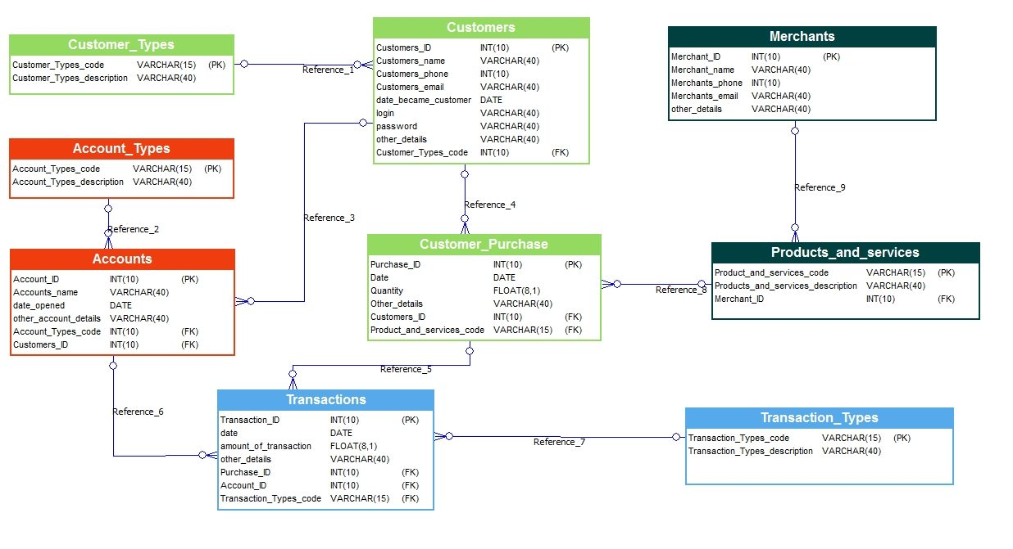
Examples: Database Model Example: Bank customer database
.

Slide 16
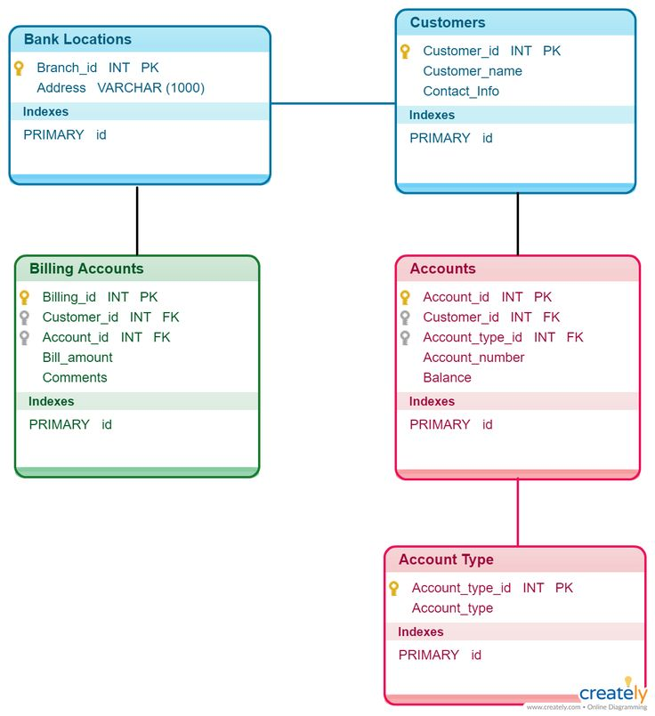
Notes:
Another example: bank customer database model

Slide 17
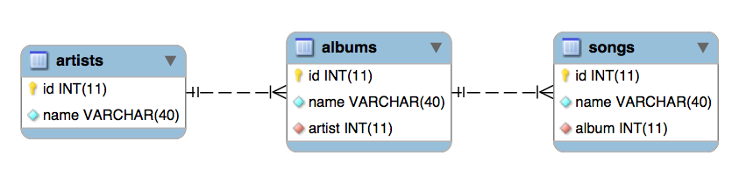
Example2: Database Music Model
ddddd
CREATE TABLE artists ( id int NOT NULL AUTO_INCREMENT, name varchar(40) NOT NULL, PRIMARY KEY(id), UNIQUE KEY(name) );
CREATE TABLE albums ( id int NOT NULL AUTO_INCREMENT, name varchar(40) NOT NULL, artist int NOT NULL, PRIMARY KEY(id), FOREIGN KEY(artist) REFERENCES artists(id) );
CREATE TABLE songs ( id int NOT NULL AUTO_INCREMENT, name varchar(40) NOT NULL, album int NOT NULL, PRIMARY KEY(id), FOREIGN KEY(album) REFERENCES albums(id) );
Notes:
SQL codes can be either in lower or upper cases. In this course we will use upper cases!

Slide 18
Starting MySQL: Command prompt/Line
When you start MySQL command prompt, you should see:
mysql>
NB: a line of codes ends with”;”
To end your MySQL session use the quit command
mysql> quit;

Slide 19
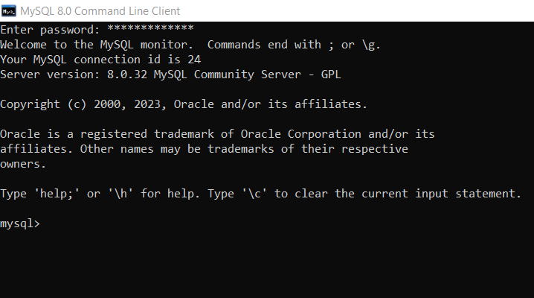
Starting MySQL: Command prompt/Line

Slide 20
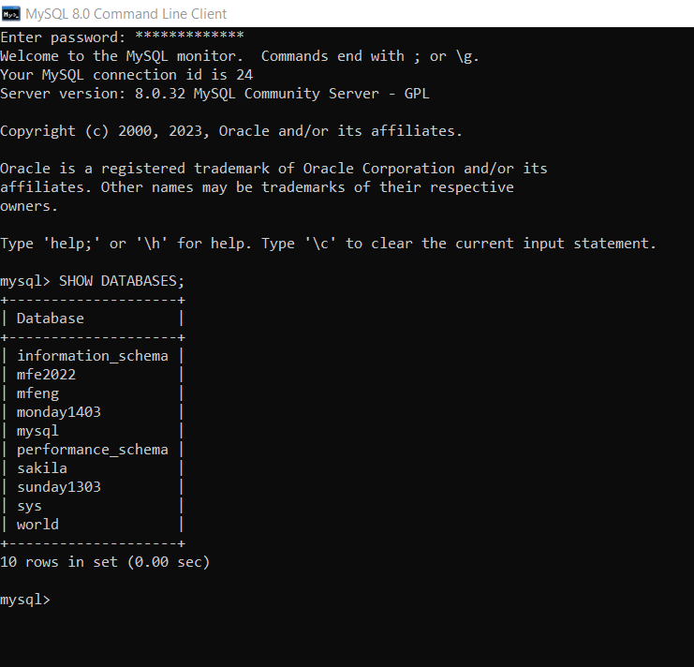
List all existing databases
List all available Databases:
mysql> SHOW databases;
Notes:
Open MySQL command prompt

Slide 21
Creating a MySQL database
use the SQL command ‘CREATE DATABASE <name>;’ ’.
mysql> CREATE DATABASE mfe2023;
Notes:
Open MySQL command prompt

Slide 22
Deleting a MySQL database
To do delete a database you need the command ‘DROP DATABASE’.
The syntax is similar to creating a database.
mysql> DROP DATABASE <name>;
mysql> DROP DATABASE mfe2023;
mysql> SHOW DATABASES;
Notes:
Open MySQL command prompt

Slide 23
Example: Create a table called “Books0”
Let us create the following normalized tables:
“Books”
“Authors”
“AuthorBook”
mysql> CREATE DATABASE mfe2024;
mysql> USE mfe2024;
mysql> CREATE TABLE Books0(BookID SMALLINT NOT NULL PRIMARY KEY,BookTitle VARCHAR(60) NOT NULL,Copyright YEAR NOT NULL);
Verify that the table is created in the database:
mysql> DESCRIBE Books0;
Notes:
Field – Indicates column name.
Type – Specifies data type for the column (varchar for characters, int for numbers).
Null – Indicates whether the column can remain with null values.
Key – Displays the primary column.
Default – Displays the column’s default value.
Extra – Indicates additional information about the columns.

Slide 24
Insert data into Books0: mysql>
mysql> INSERT INTO Books0 VALUES (12786, 'Letters to a Young Poet', 1934);
INSERT INTO Books0 VALUES(13331, 'Winesburg, Ohio', 1919);
INSERT INTO Books0 VALUES(14356, 'Hell\'s Angels', 1966);
INSERT INTO Books0 VALUES(15729, 'Black Elk Speaks', 1932);
INSERT INTO Books0 VALUES(16284, 'Noncomformity', 1996);
INSERT INTO Books0 VALUES(17695, 'A Confederacy of Dunces', 1980);
INSERT INTO Books0 VALUES(19264, 'Postcards', 1992);
INSERT INTO Books0 VALUES(19354, 'The Shipping News', 1993);

Slide 25
ALTERNATIVE CODE:
mysql> INSERT INTO Books0 VALUES (12786, 'Letters to a Young Poet', 1934),
(13331, 'Winesburg, Ohio', 1919),
(14356, 'Hell\'s Angels', 1966),
(15729, 'Black Elk Speaks', 1932),
(16284, 'Noncomformity', 1996),
(17695, 'A Confederacy of Dunces', 1980),
(19264, 'Postcards', 1992),
(19354, 'The Shipping News', 1993);
Notes:
Explain the Tables and questions in Assignment2

Slide 26
Display the Table: Books
mysql> SELECT * FROM Books0;

Slide 27
Create 2nd Table: “Authors”
mysql> CREATE TABLE Authors
(
AuthID SMALLINT NOT NULL PRIMARY KEY,
AuthFN VARCHAR(20),
AuthMN VARCHAR(20),
AuthLN VARCHAR(20)
);
Visualise the columns
mysql> DESCRIBE Authors;

Slide 28
Insert data into Books
mysql> INSERT INTO Authors
VALUES (1006, 'Hunter', 'S.', 'Thompson'),
(1007, 'Joyce', 'Carol', 'Oates'),
(1008, 'Black', NULL, 'Elk'),
(1009, 'Rainer', 'Maria', 'Rilke'),
(1010, 'John', 'Kennedy', 'Toole'),
(1011, 'John', 'G.', 'Neihardt'),
(1012, 'Annie', NULL, 'Proulx'),
(1013, 'Alan', NULL, 'Watts'),
(1014, 'Nelson', NULL, 'Algren');

Slide 29
VISUALISE THE TABLE: “Authors
mysql> SELECT * FROM Authors;

Slide 30
Create 3rd Table: “AuthorBook”
mysql> CREATE TABLE AuthorBook
(
AuthID SMALLINT NOT NULL,
BookID SMALLINT NOT NULL,
PRIMARY KEY (AuthID, BookID),
FOREIGN KEY (AuthID) REFERENCES Authors (AuthID),
FOREIGN KEY (BookID) REFERENCES Books0 (BookID)
);
Visualise Columns:
mysql> DESCRIBE AuthorBook;

Slide 31
Insert Data into AuthorBook
mysql> INSERT INTO AuthorBook
VALUES (1006, 14356), (1008, 15729),
(1009, 12786), (1010, 17695),
(1011, 15729), (1012, 19264),
(1012, 19354), (1014, 16284);

Slide 32
Visualize “AuthorBook” table
mysql> SELECT * FROM AuthorBook;

Slide 33
IMPORTANT COMMANDS
Creating a database:
mysql> CREATE DATABASE mfe2024;
First identify all Databases you have:
mysql>SHOW databases;
Secondly, choose a specific database:
mysql> USE mfe2024;
Third: from the selected database, identify all its tables
(CREATE TABLE AuthorBook (…)
mysql> SHOW TABLES;
Display the contents of the Table:
mysql> DESCRIBE AuthorBook;
mysql> SELECT * FROM AuthorBook;

Slide 34
SQL JOIN clause !
An SQL JOIN clause is used to combine rows from two or more tables, based on a common field between them.
The most common type of join is: SQL INNER JOIN (simple join). An SQL INNER JOIN return all rows from multiple tables where the join condition is met.

Slide 35
“JOIN” INNER JOIN SYNTAX
mysql> SELECT column_name(s)
FROM table1
INNER JOIN table2
ON table1.column_name=table2.column_name;
OR
mysql> SELECT column_name(s)
FROM table1
JOIN table2
ON table1.column_name=table2.column_name;

Slide 36
Joining Database Tables
Joinning Books and AuthorBook tables on similar column=‘BookID’
mysql> SELECT * FROM Books0 JOIN AuthorBook ON Books0.BookID=AuthorBook.BookID;
Joinning all 3 tables:
mysql> SELECT * FROM Books0 INNER JOIN AuthorBook ON Books0.BookID=AuthorBook.BookID INNER JOIN Authors ON Authors.AuthID=AuthorBook.AuthID;

Slide 37
Joining Database Tables
Joinning Books, Authors, and AuthorBook tables at once on identical columns, then order by book title:
mysql> SELECT * FROM Books0, AuthorBook, Authors WHERE Books0.BookID=AuthorBook.BookID AND AuthorBook.AuthID=Authors.AuthID ORDER BY Books0.BookTitle;

Slide 38
Basic “Join” All Columns for selected tables
Joining all columns from the 3 tables at once:
mysql> SELECT * FROM Books0, AuthorBook, Authors;

Slide 39
Basic Join 1: on selected columns
mysql> SELECT BookTitle, Copyright, Authors.AuthID
FROM Books0, AuthorBook, Authors
ORDER BY BookTitle;

Slide 40
Basic Join 2
mysql> SELECT BookTitle, Copyright, AuthID
FROM Books0 AS b, AuthorBook AS ab
WHERE b.BookID=ab.BookID
ORDER BY BookTitle;

Slide 41
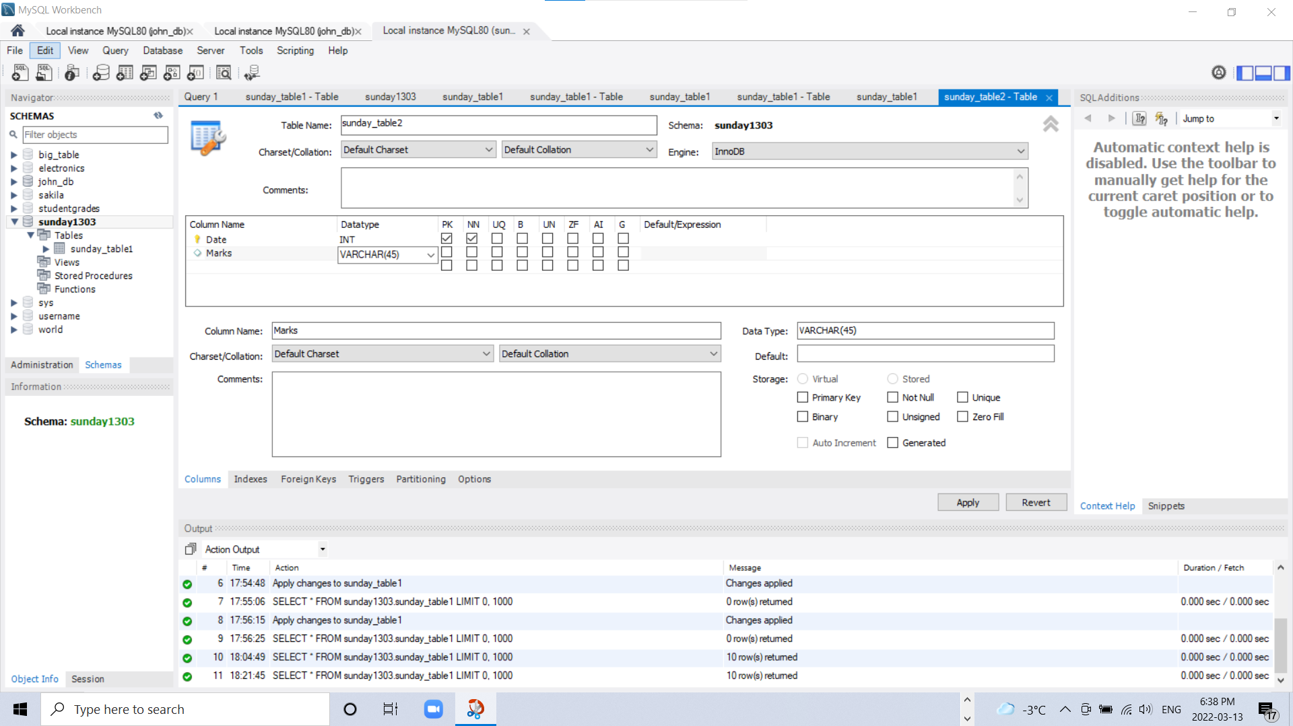
MySQL using Workbench
.

